Slide 1


GROUP 8
Python Programming Project
Bank Customer Churn Prediction Final Phase
AKSHAY JADHAV
02-December-2020

Slide 2

Agenda
Business Problem Statement
Goal
Predictive Modeling
Comparison of MLA Metrics

Slide 3


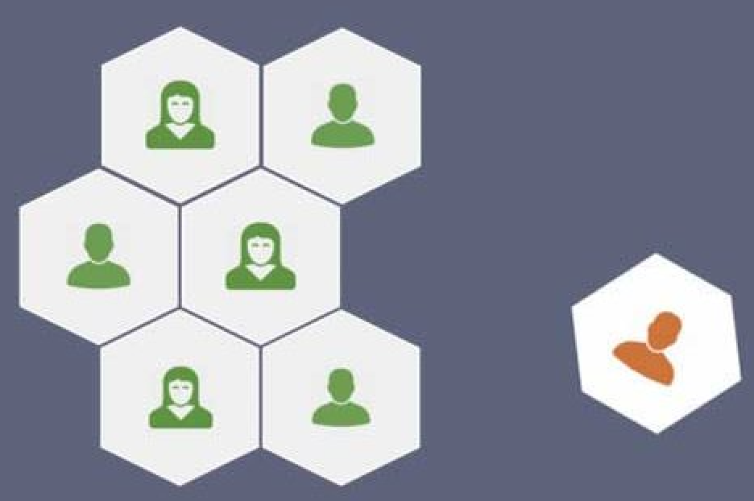
Business Problem Statement
There are a lot of customers who have decided to end their relationship with the bank. It could happen due to variety of reasons as below:
Bad Customer Service
Bad Onboarding
Lack of Ongoing Customer Success
The Bank stakeholders want the BI team to work on the bank customers data and help them to upgrade the Marketing Acquisition policies to welcome new customers and to maintain current customers.
For that purpose, BI team need to work on strategies to classify the customers who are going to churn and loyal customers by predicting possible churn customers to avoid a direct loss of Marketing Acquisition Cost and Future revenues.

Slide 4

GOAL
To build a best predictive or machine learning model to predict the probability of churn customers, conditioned on the customer features.

Slide 5

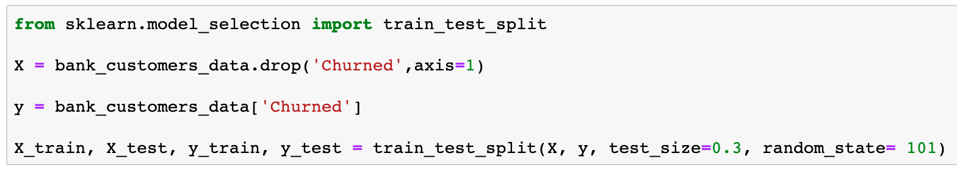
Predictive Modeling
Train Test Split
Import train_test_split from model_selection
Separate the features and target variable/attribute
Split the dataset into train (70%) and test (30%) datasets
X_train – Training Independent Features
X_test – Test Independent Features
y_train – Train target variable (Dependent)
y_test – Test data target variable (Dependent)

Slide 6

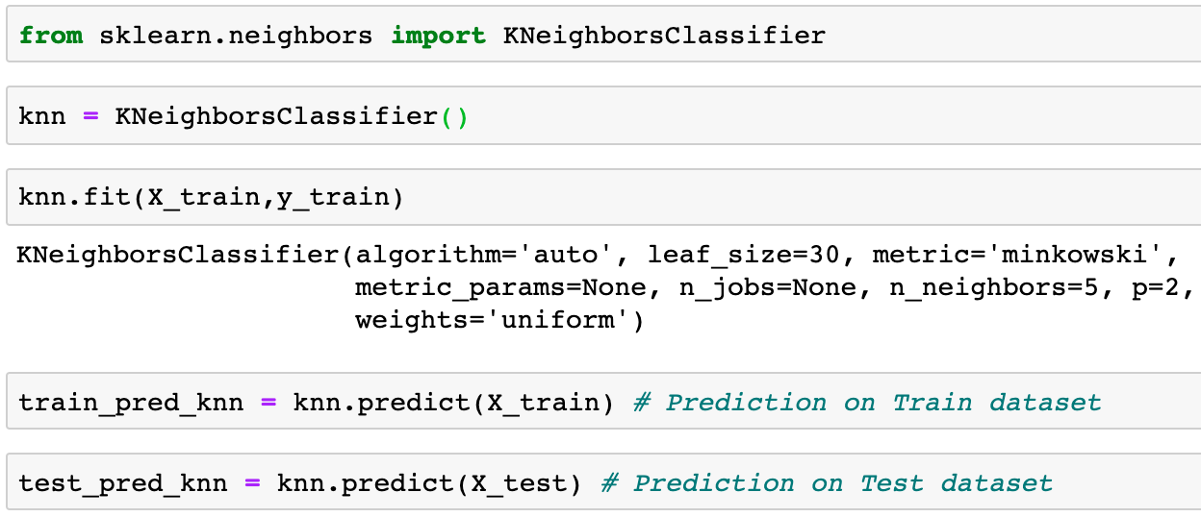
Predictive Modeling
K-Nearest Neighbor (KNN)
2.1
Training the model using default Hyperparameters
Import KNeighborsClassifier from neighbors
Fit the model to the train split of data
Predictions using training data features
Predictions using test data features

Slide 7
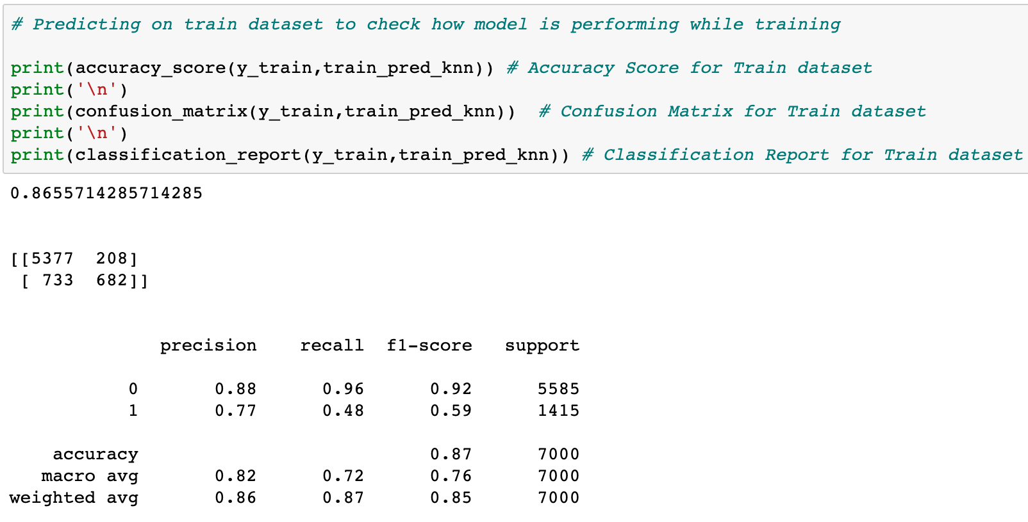
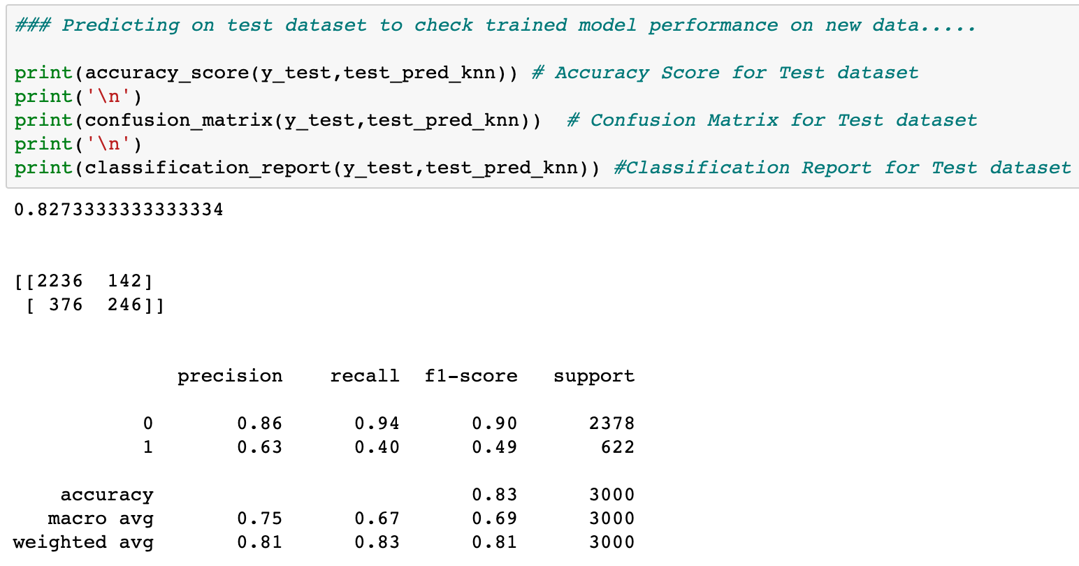
Predictive Modeling
K-Nearest Neighbor (KNN)
Performance Metrics
Train Dataset
Test Dataset

Slide 8
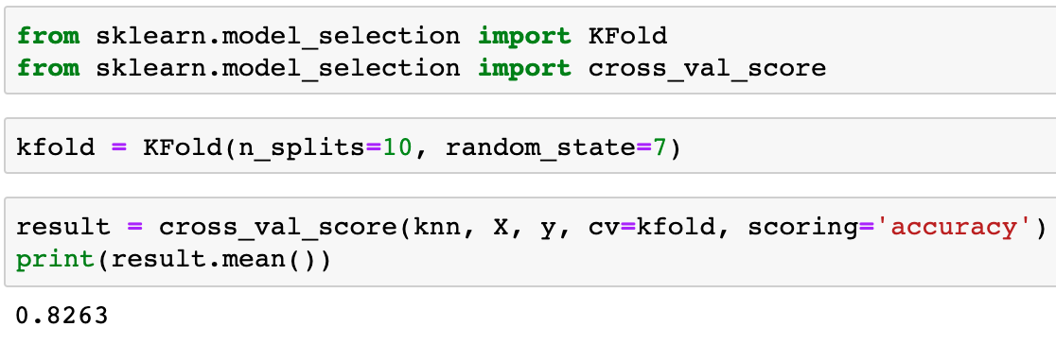
Predictive Modeling
K-Nearest Neighbor (KNN)
2.2
K-Fold Cross Validation Technique
I have used K-fold cross validation technique to allow every sample in the dataset get a chance to be tested which in turn reduces the problem of overfitting

Slide 9
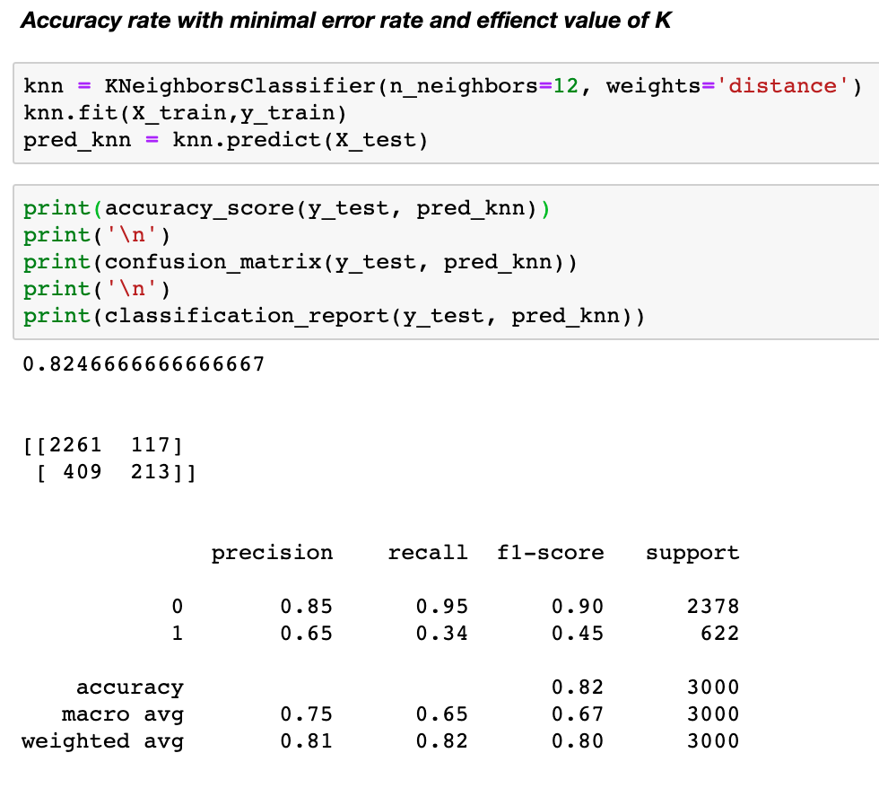
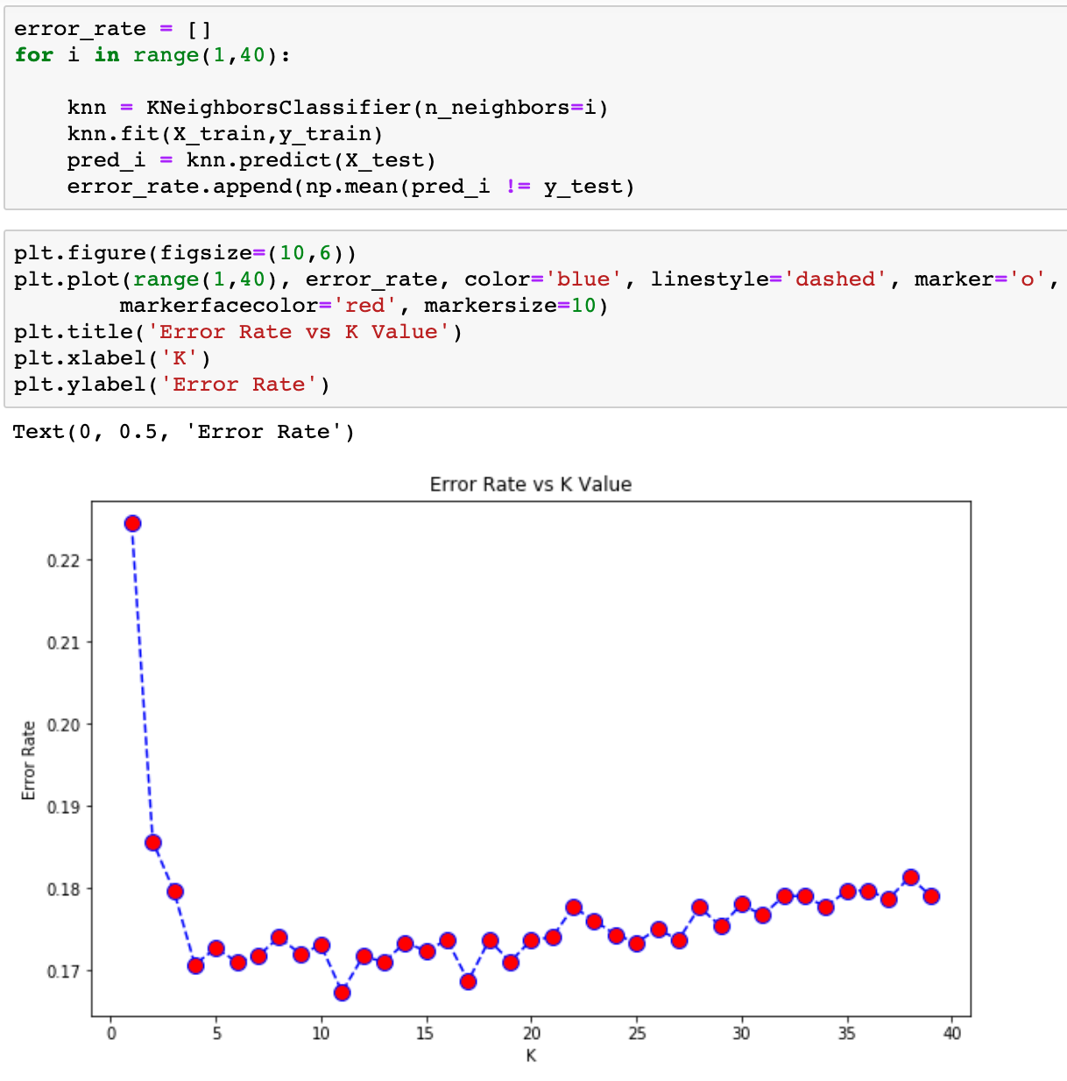
Predictive Modeling
K-Nearest Neighbor (KNN)
2.3
HyperParameter Tuning Technique
2.3.1
Elbow Method for choosing best value of K

Slide 10
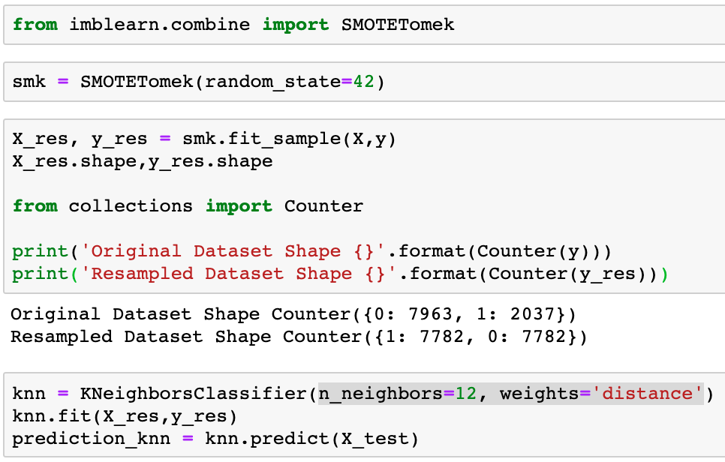
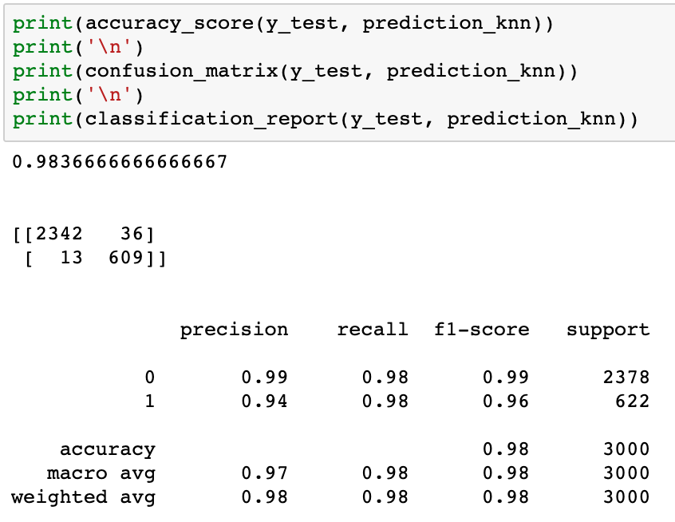
Predictive Modeling
K-Nearest Neighbor (KNN)
2.4
Oversampling technique – SMOTE Analysis

Slide 11
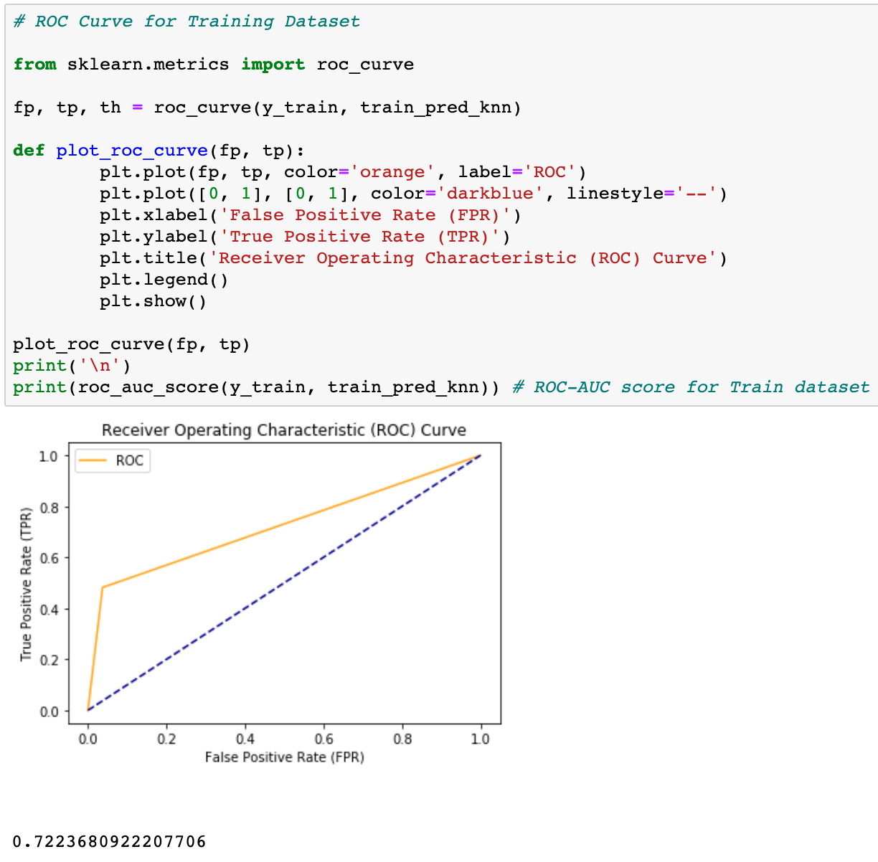
Predictive Modeling
K-Nearest Neighbor (KNN)
2.5
ROC Curve for Train set
Area Under Curve (AUC) Score:
0.72

Slide 12
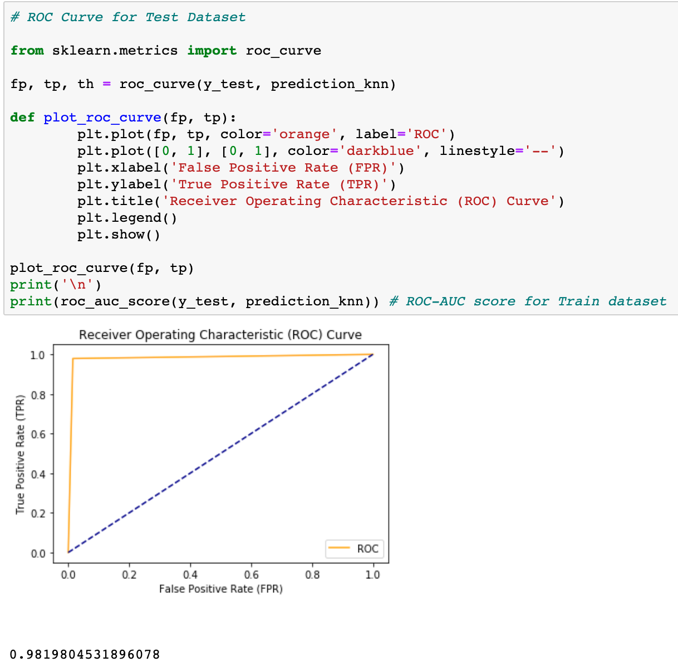
Predictive Modeling
K-Nearest Neighbor (KNN)
2.5
ROC Curve for Test set
Area Under Curve (AUC) Score:
0.98

Slide 13
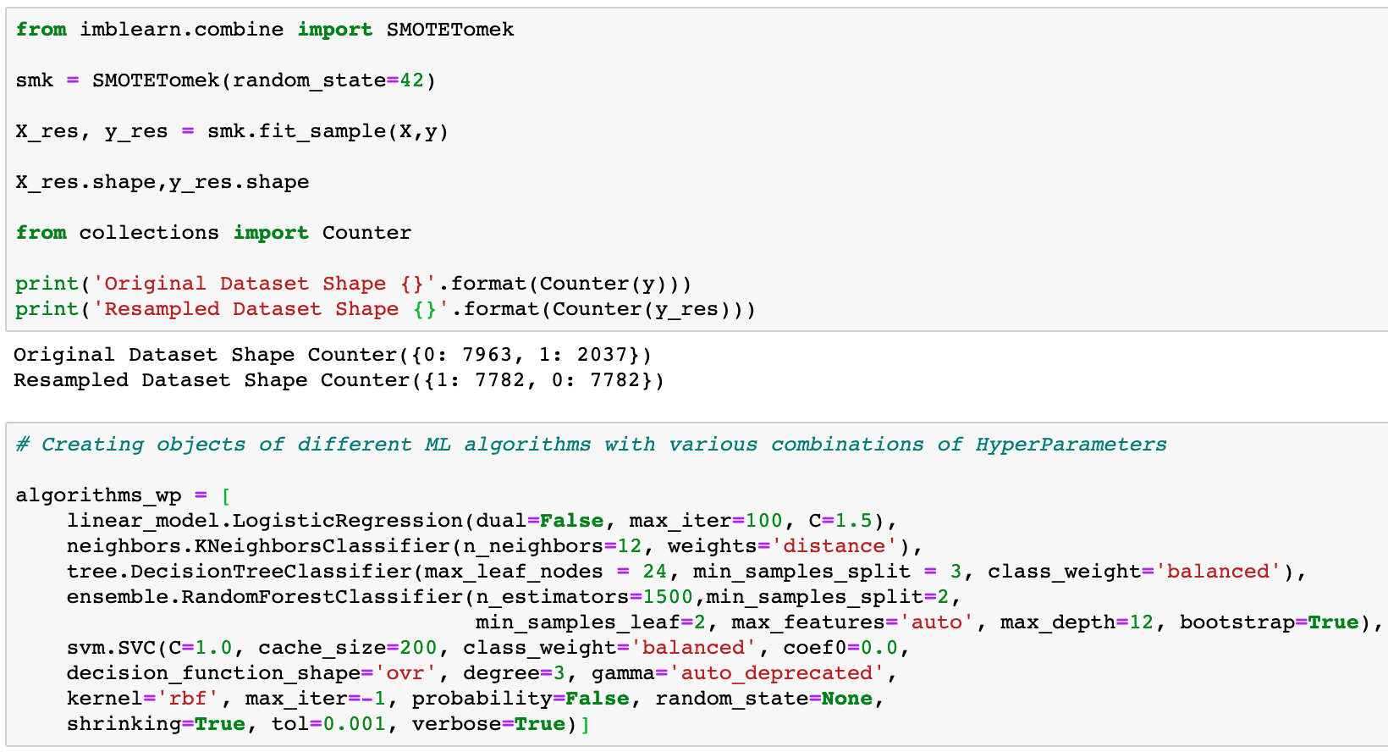
Comparison of MLA Metrics
Oversampled the Minority Class (Class 1)
Created a list objects of different ML algorithms with best combination of parameters.

Slide 14
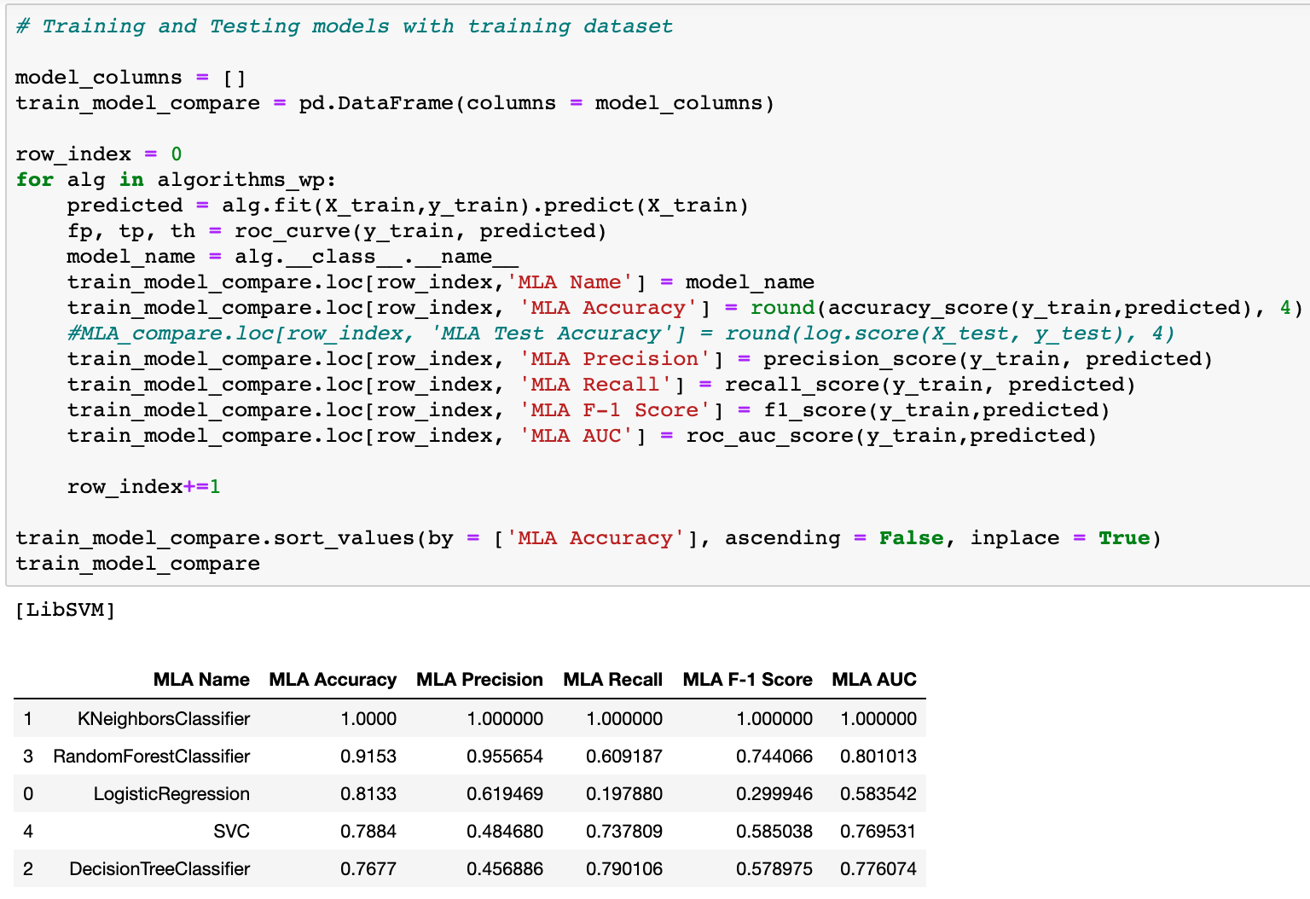
Comparison of MLA Metrics
Training and predicting using train dataset
Comparison of accuracy rate from different trained algorithms

Slide 15
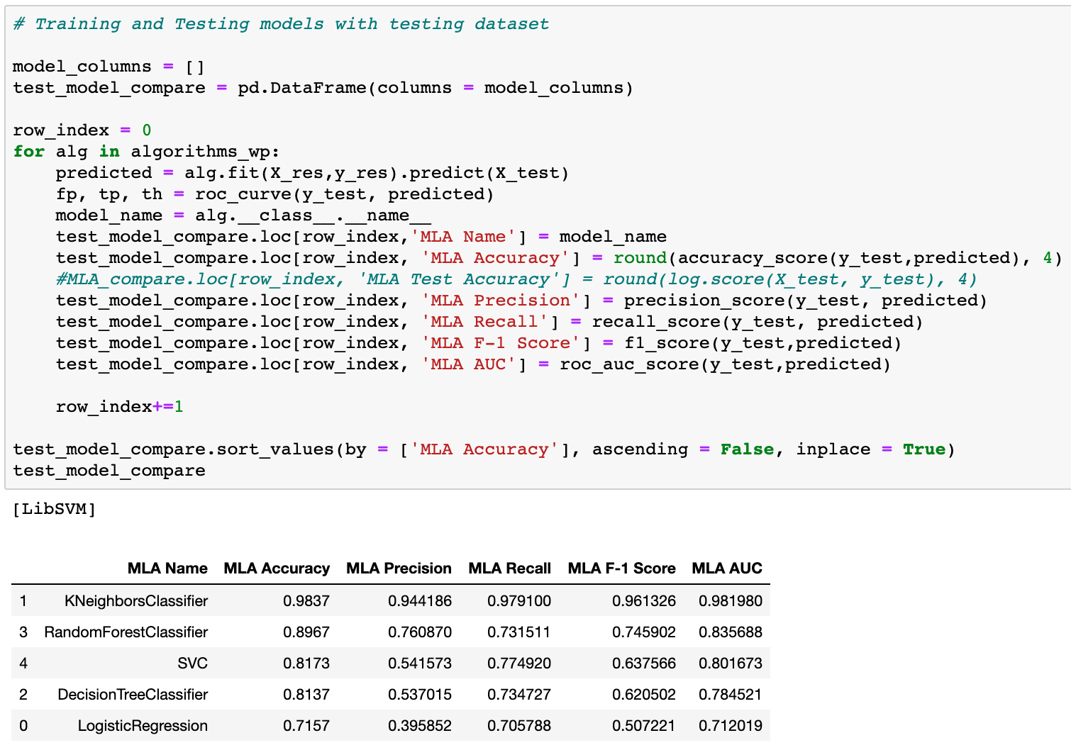
Comparison of MLA Metrics
Training and predicting using test dataset
Comparison of accuracy rate from different algorithms on test dataset

Slide 16
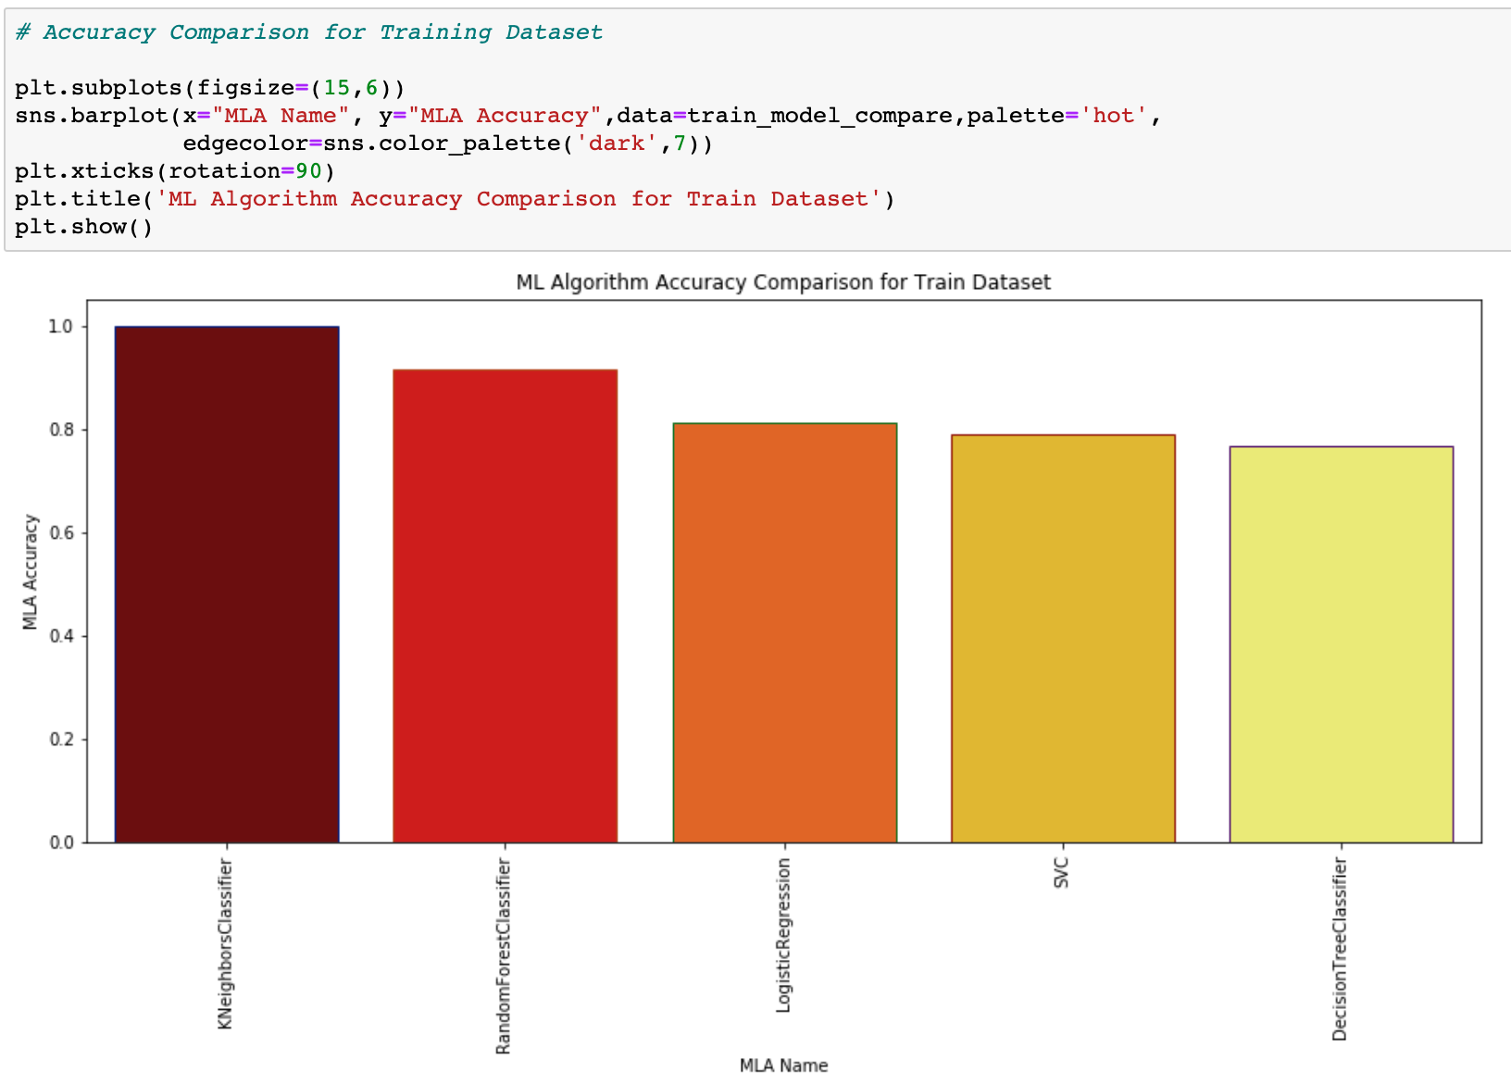
Comparison of MLA Metrics

Slide 17

Comparison of MLA Metrics

Slide 18





Findings
Clearly, the KNN model accuracy has increased from 82.73% to 98.37%. Hence, the KNN model can be considered in production for deployment
The False Positive Rate (FPR) in this model is calculated as => FP/(FP+TN)
= 1.51% ~ which is good!
The False Negative Rate (FNR) in this model is calculated as => FN/(FN+TP)
= 2.09%
AUC Score of model on train dataset : 0.72
AUC Score of model on test dataset : 0.98
Since there is no much difference in both AUC scores,
we can say that KNN model does not overfit.
Based on above findings, we could say KNN could be the best generalized machine learning algorithm that could predict well on unseen data.
KNN Model accuracy has increased from 82.73% to 98.37%
KNN Model is good and can be considered for deployment.

Slide 19
Conclusion and Insights
BI team got successful in building best generalized machine learning algorithm to classify between churn and loyal bank customers.
We have found some valuable insights while analyzing the data and training machine learning algorithms are,
Female of age around 40 with higher salaries could churn more.
Churn Customers’ count are way lower in comparison to loyal customers, so we can take necessary actions and overcome the problems for small amount of churn customers.
Based on data analysis and predictive modeling, we could say there are some important features which mainly contributes to classifying the customers as Churn or Loyal,
Age
Gender
Salary

Slide 20
THANK YOU

